Slide 1
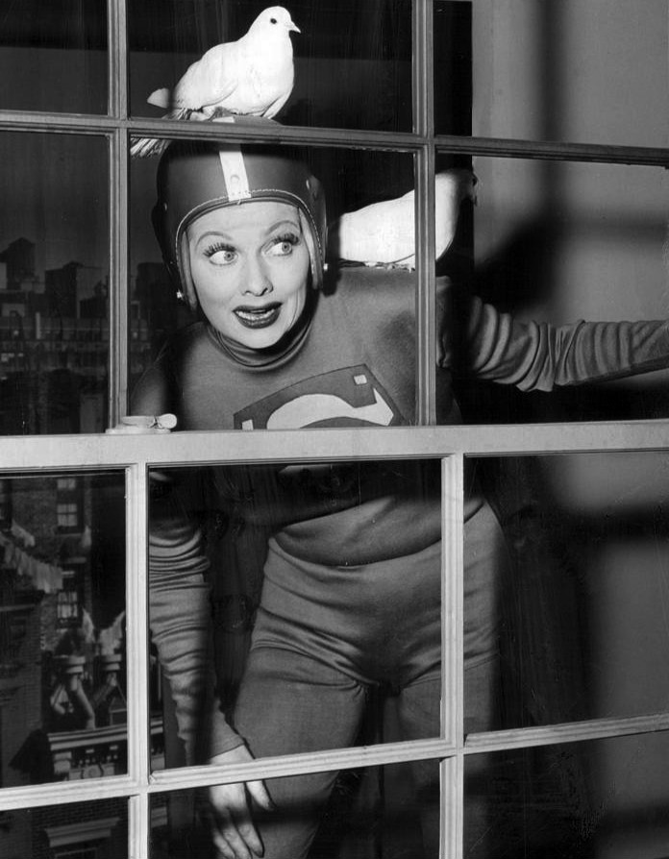
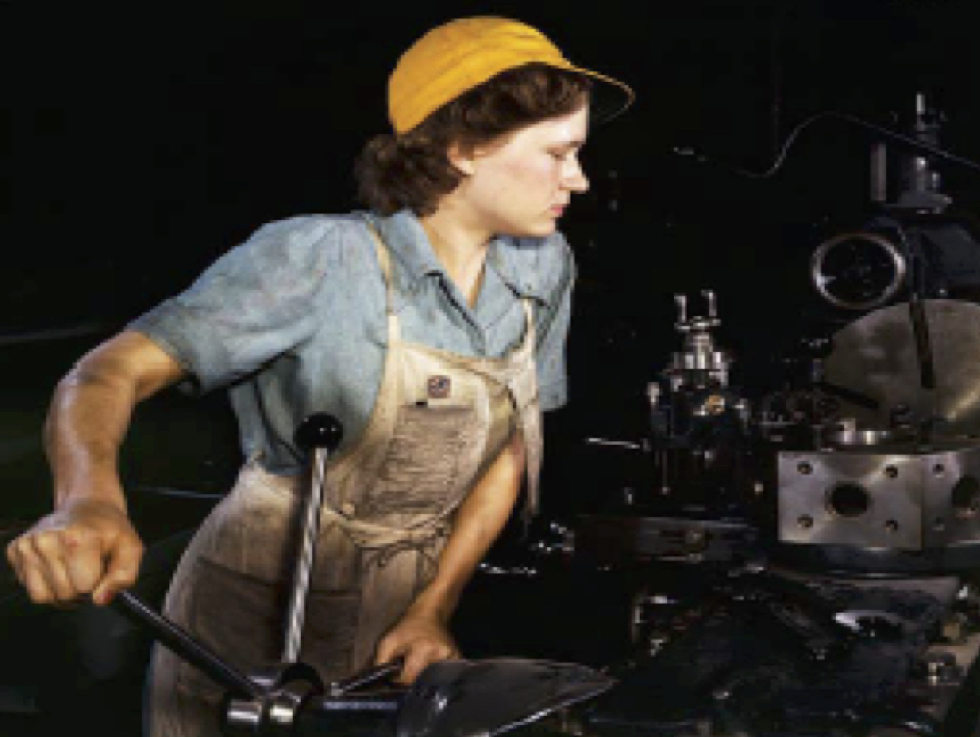
From Homefront to American Dream
1941-1957
History 104 w/Nicholas Levis
Spring 2022 @ Queens College
Intro to American History II – Week 8

Slide 2
the big turn: preparing for war, 1939-41

Slide 3
Preparing for War
U.S. cuts off supplies to Japanese war machine, 1940-41
Fall 1940: after fall of France & blitz against Britain, U.S. begins providing ships & supplies to Britain
Can’t get butter through Congress? Try military spending.
Draft Act, 1940 – registration, not yet conscription
Four Freedoms Speech, Jan. 1941
Lend-Lease Act, 1941, makes it official
Public-private propaganda offensive...

Slide 4
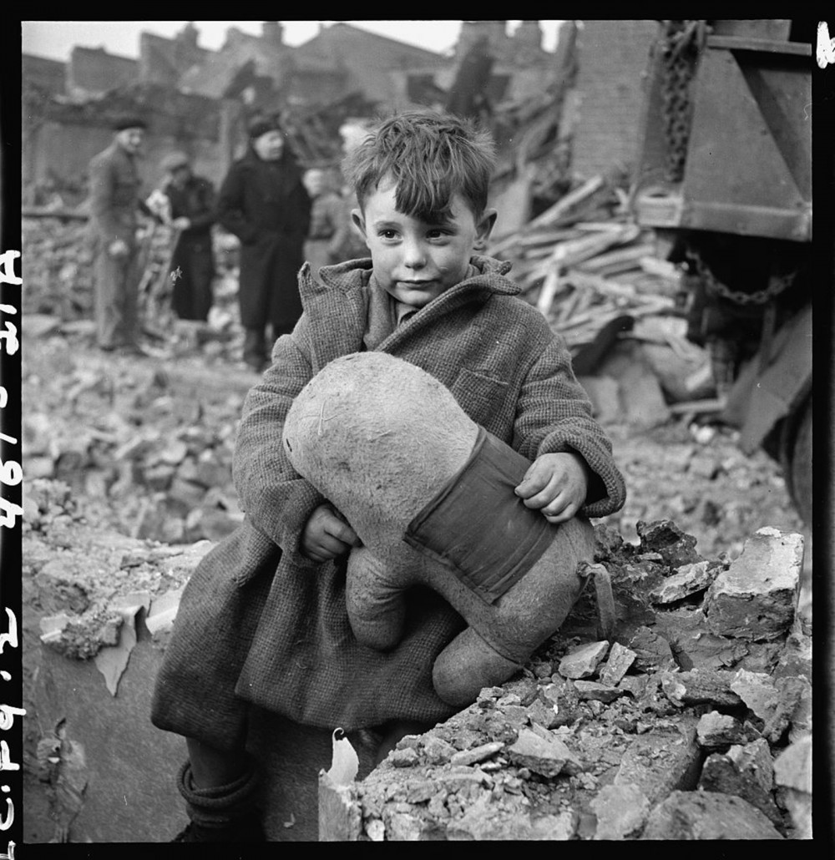
London Blitz
September 1940

Slide 5
four freedoms

Slide 6
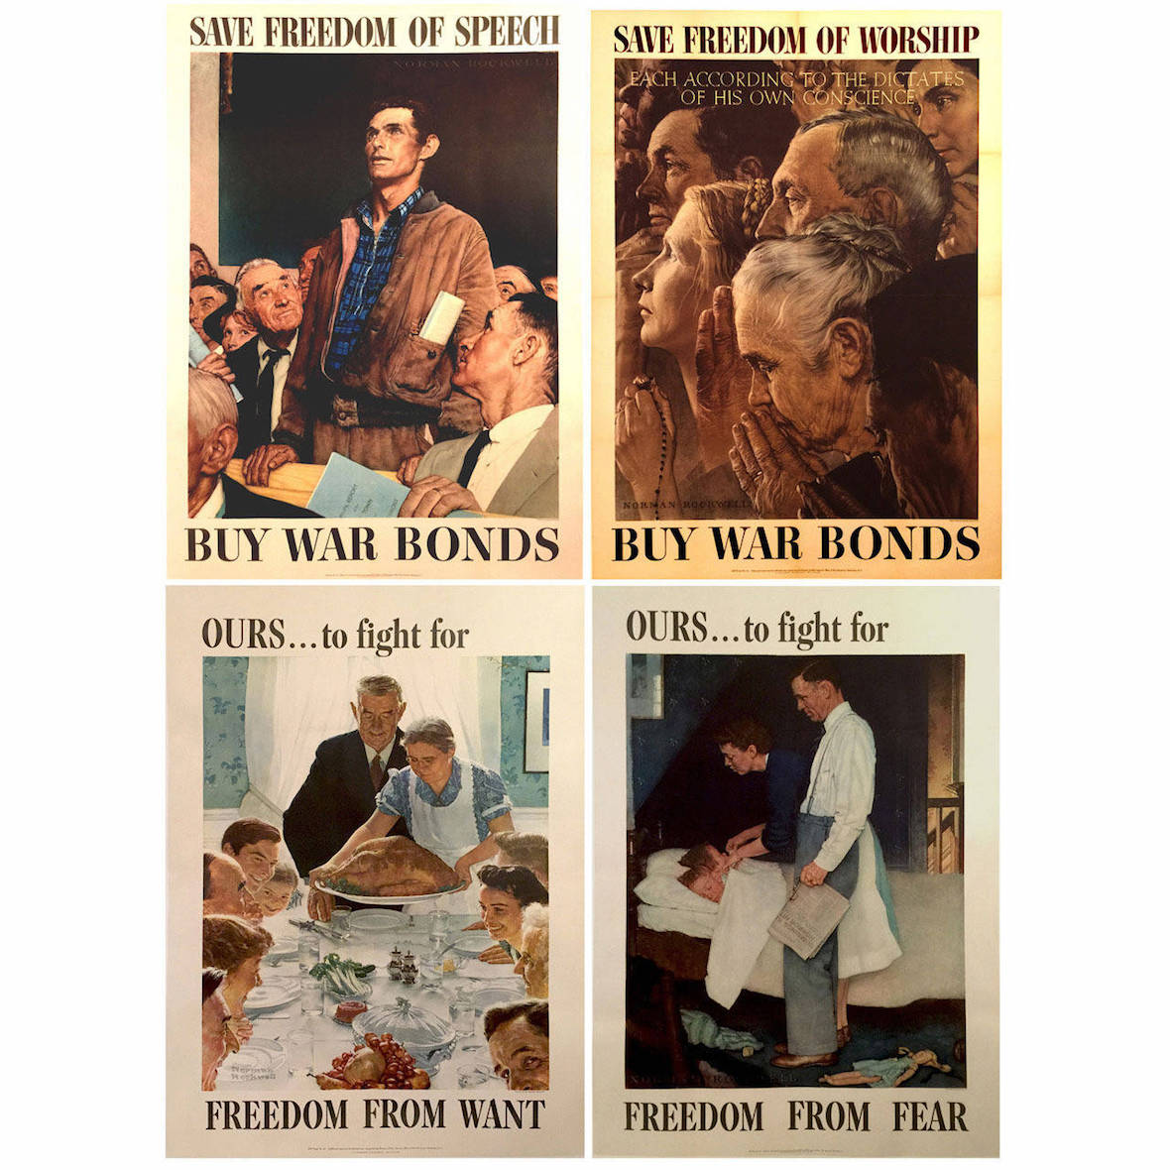
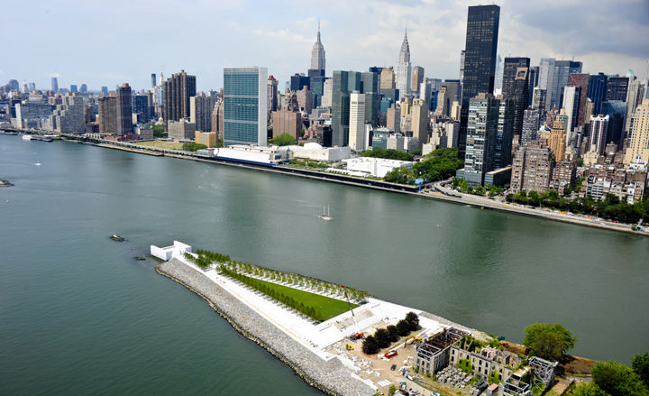

Slide 7
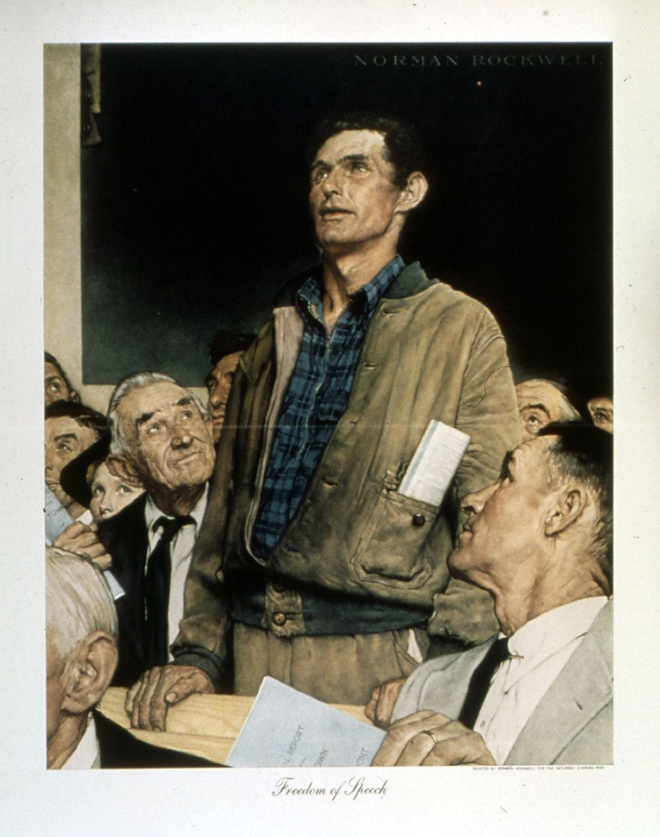
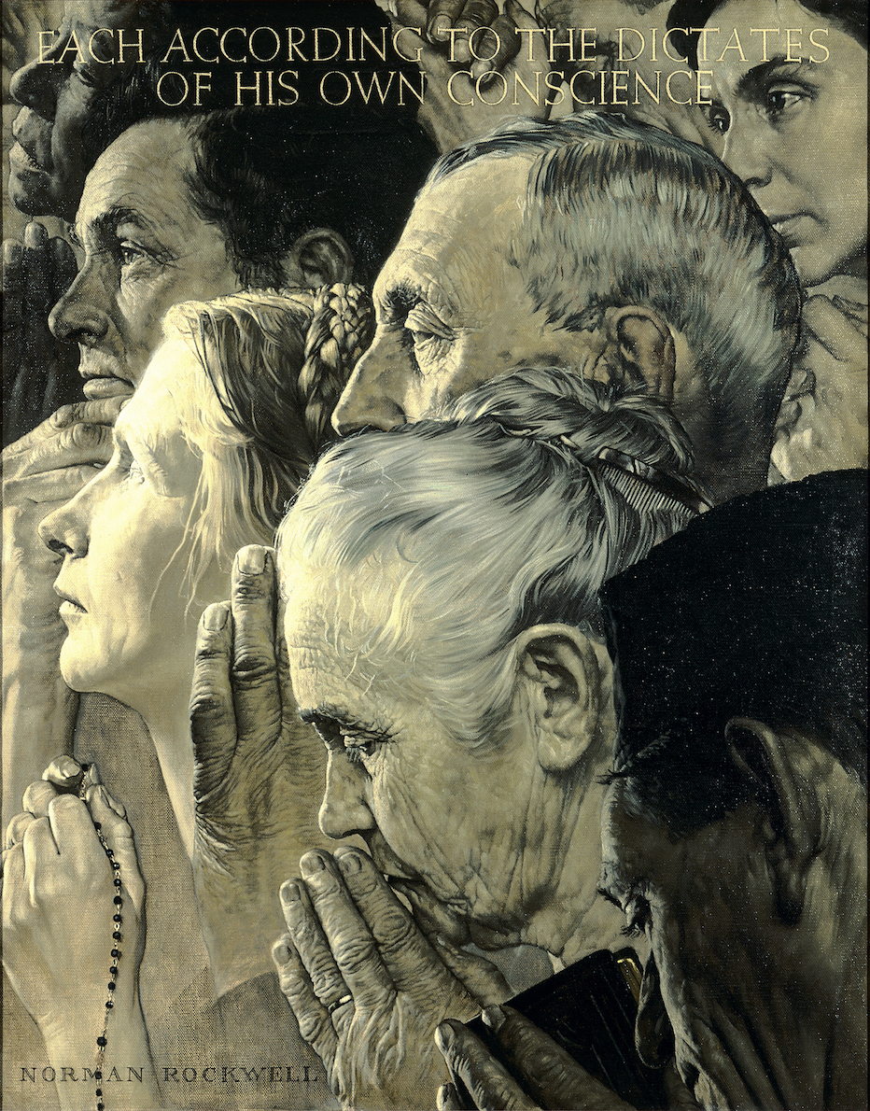

Slide 8
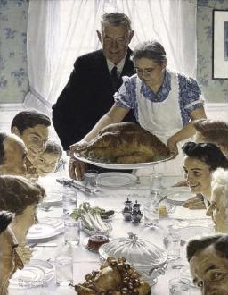
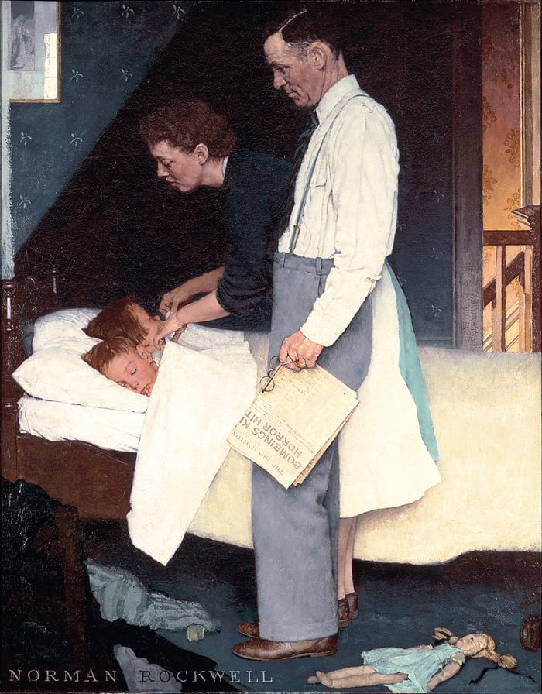

Slide 9
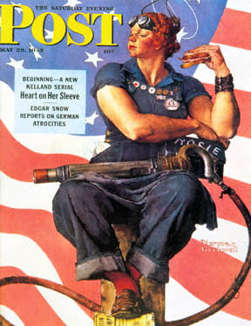

Norman Rockwell, unofficial propaganda artist of the New Deal, perhaps best known for the image to the left. Otherwise his was a vision of America much like Frank Capra’s in cinema.

Slide 10
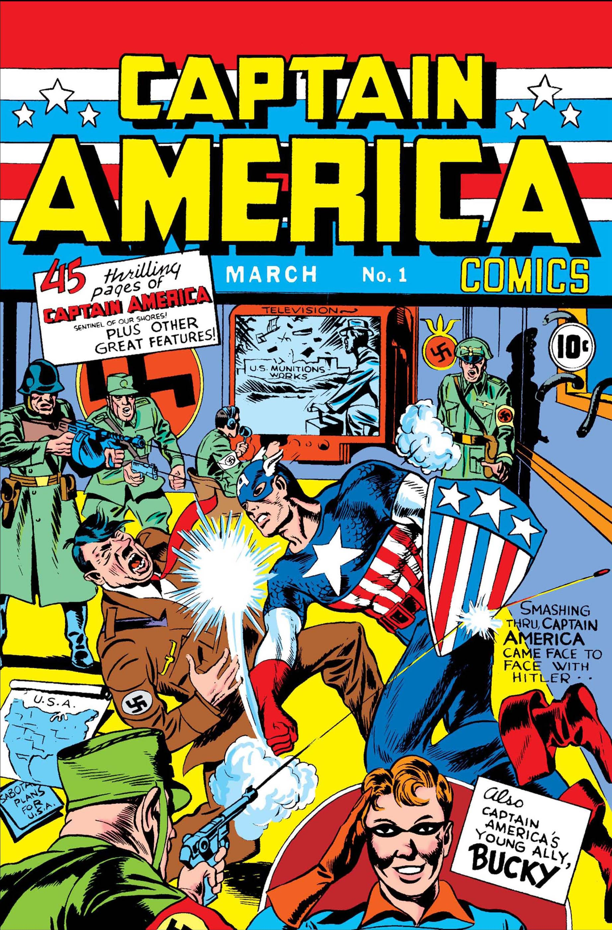
Captain America
(Kirby &Simon)
Dated March 1941, Captain America No. 1, with the famous cover of the super soldier punching Hitler, circulated after “The Four Freedoms” speech but well before US entry into war hostilities.

Slide 11
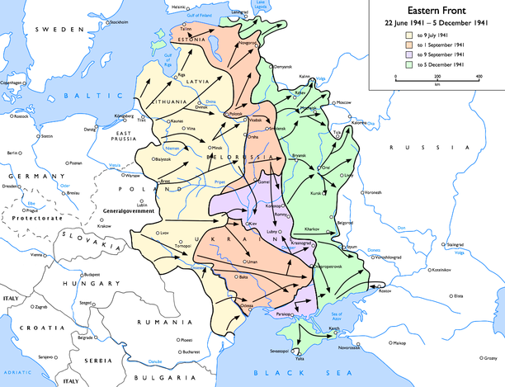

Slide 12
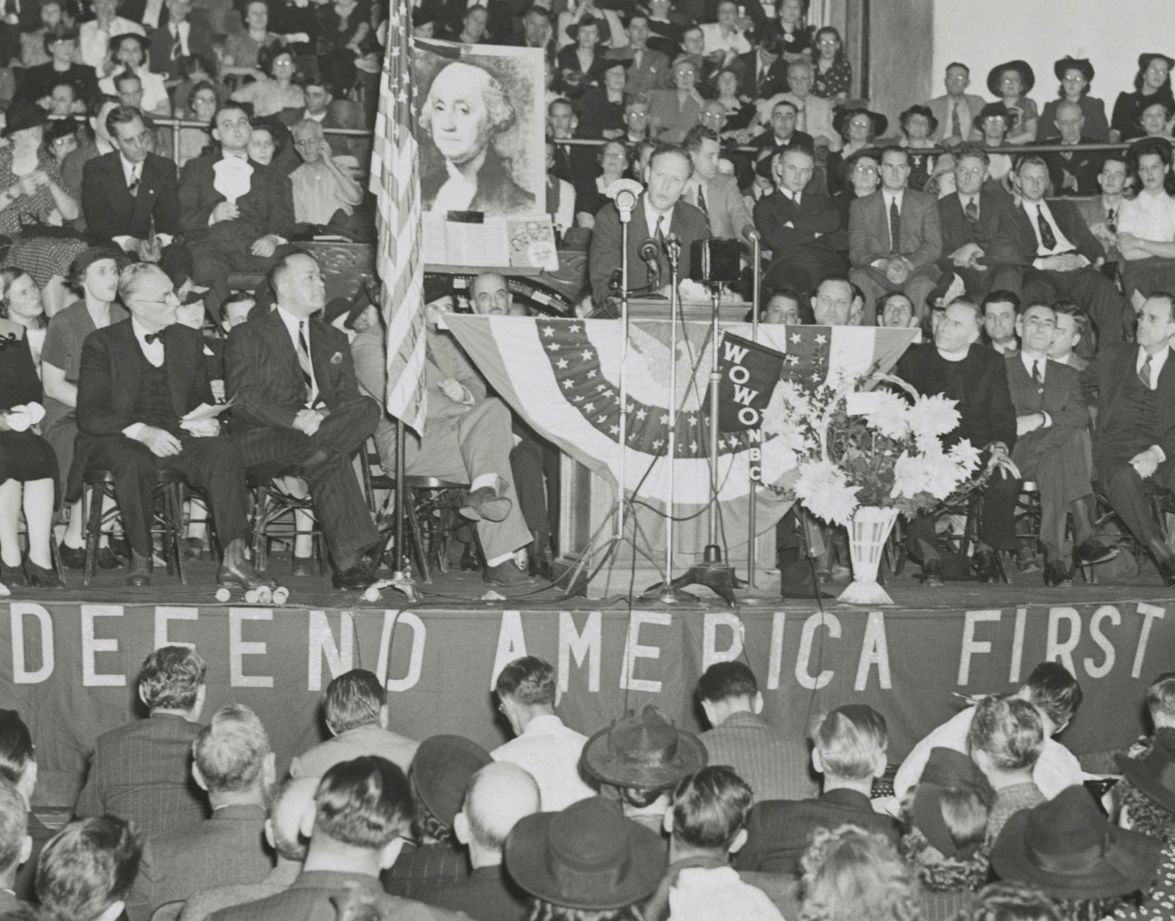

Slide 13
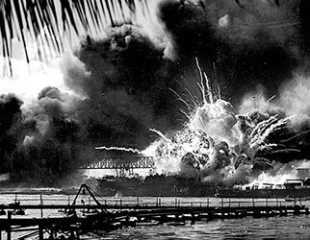
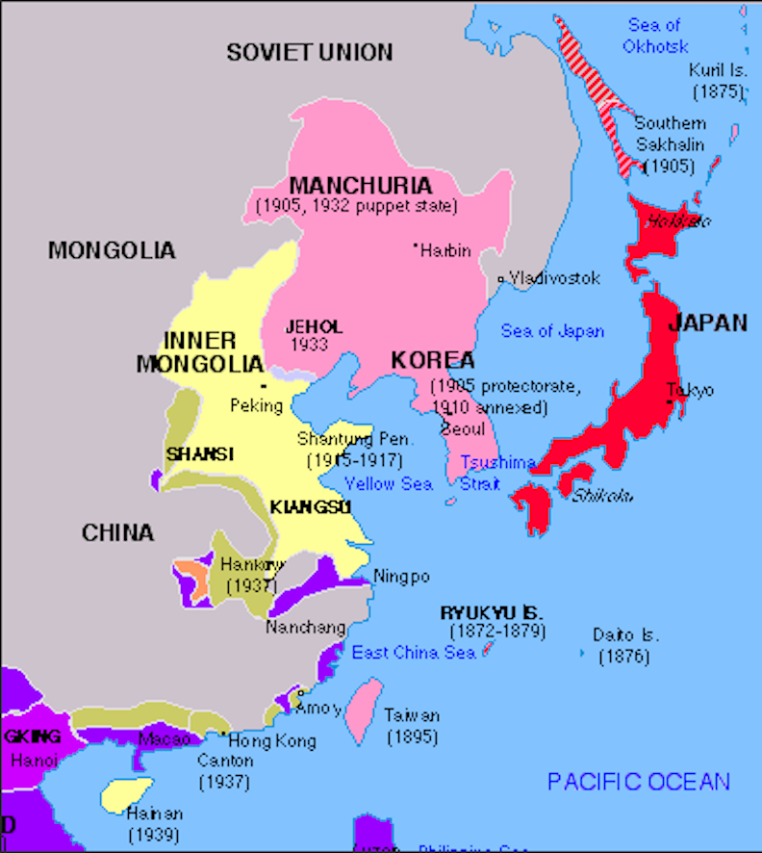
6 Dec. 1941
1940
Pearl Harbor attack

Slide 16

February 1941
Henry Luce: “The American Century”

Slide 17
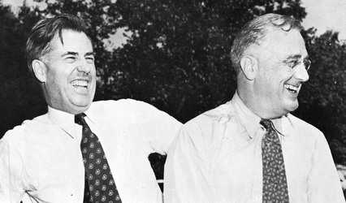

Slide 18
(Pause for Boogie Woogie Bugle Boy clip)

Slide 19
Delay due to Balkan offensive
Surprise invasion 22 June 1941
Blitzkrieg success
German allies: Romania, Bulgaria, Hungary, Finland, Ukrainian and Baltic nationalist militias.
SS Sonderkommandos
“The First Million” of Holocaust
3 million Soviet POWs in first 3 months
Leningrad withstands siege. War turns in battle at gates of Moscow, 4-6 Dec.
Forced labor draft spring 1942
Partisan warfare
Caucasus offensive, 1942
Stalingrad: Oct 1942-Feb 1943

Slide 20
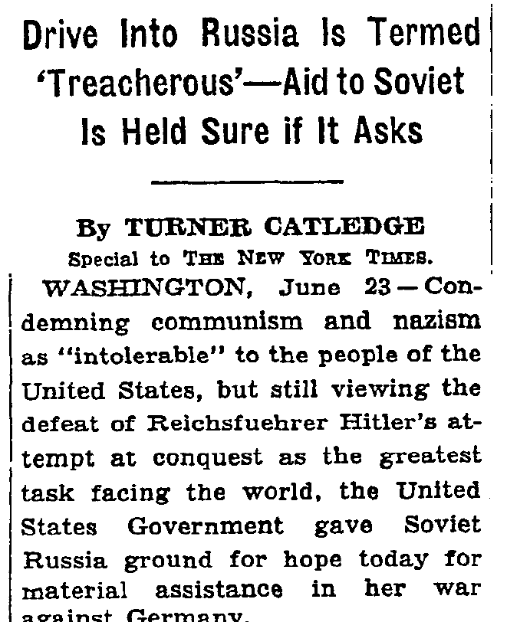
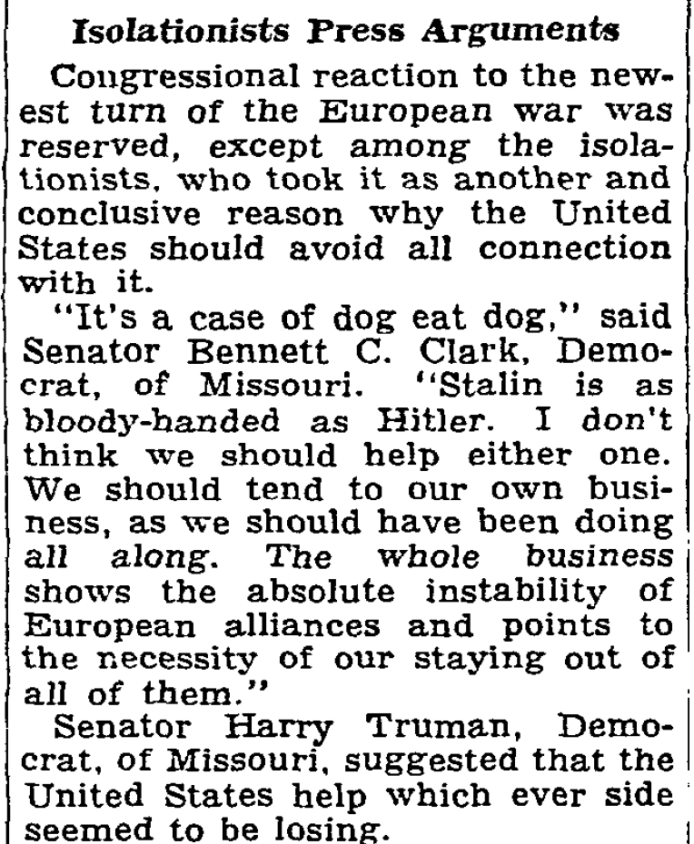
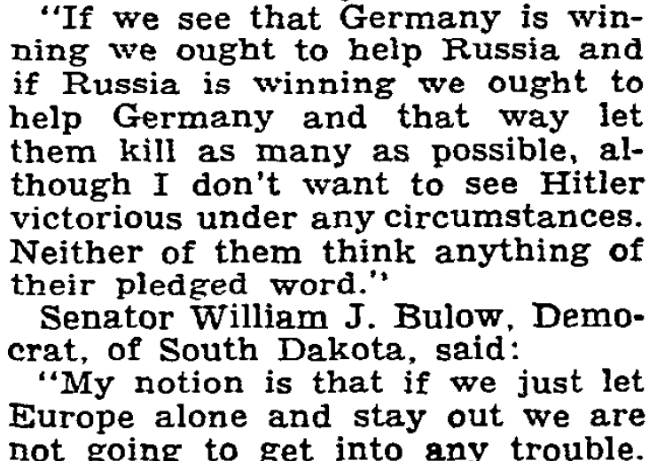
“Our Policy Stated,” New York Times, June 23, 1941
[…]

Slide 21
1940
1941

Slide 22
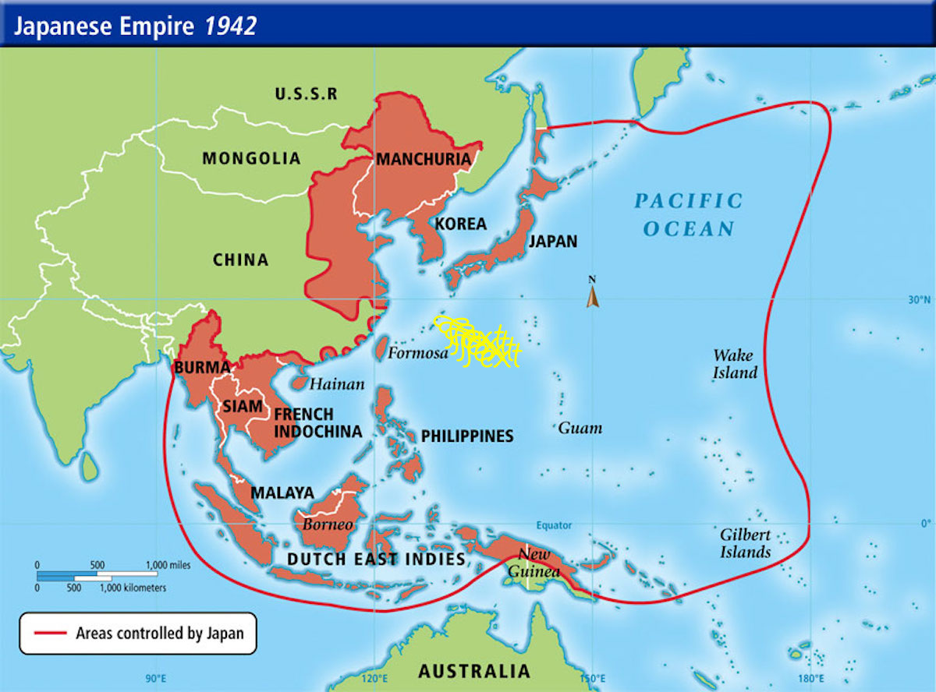


Slide 23
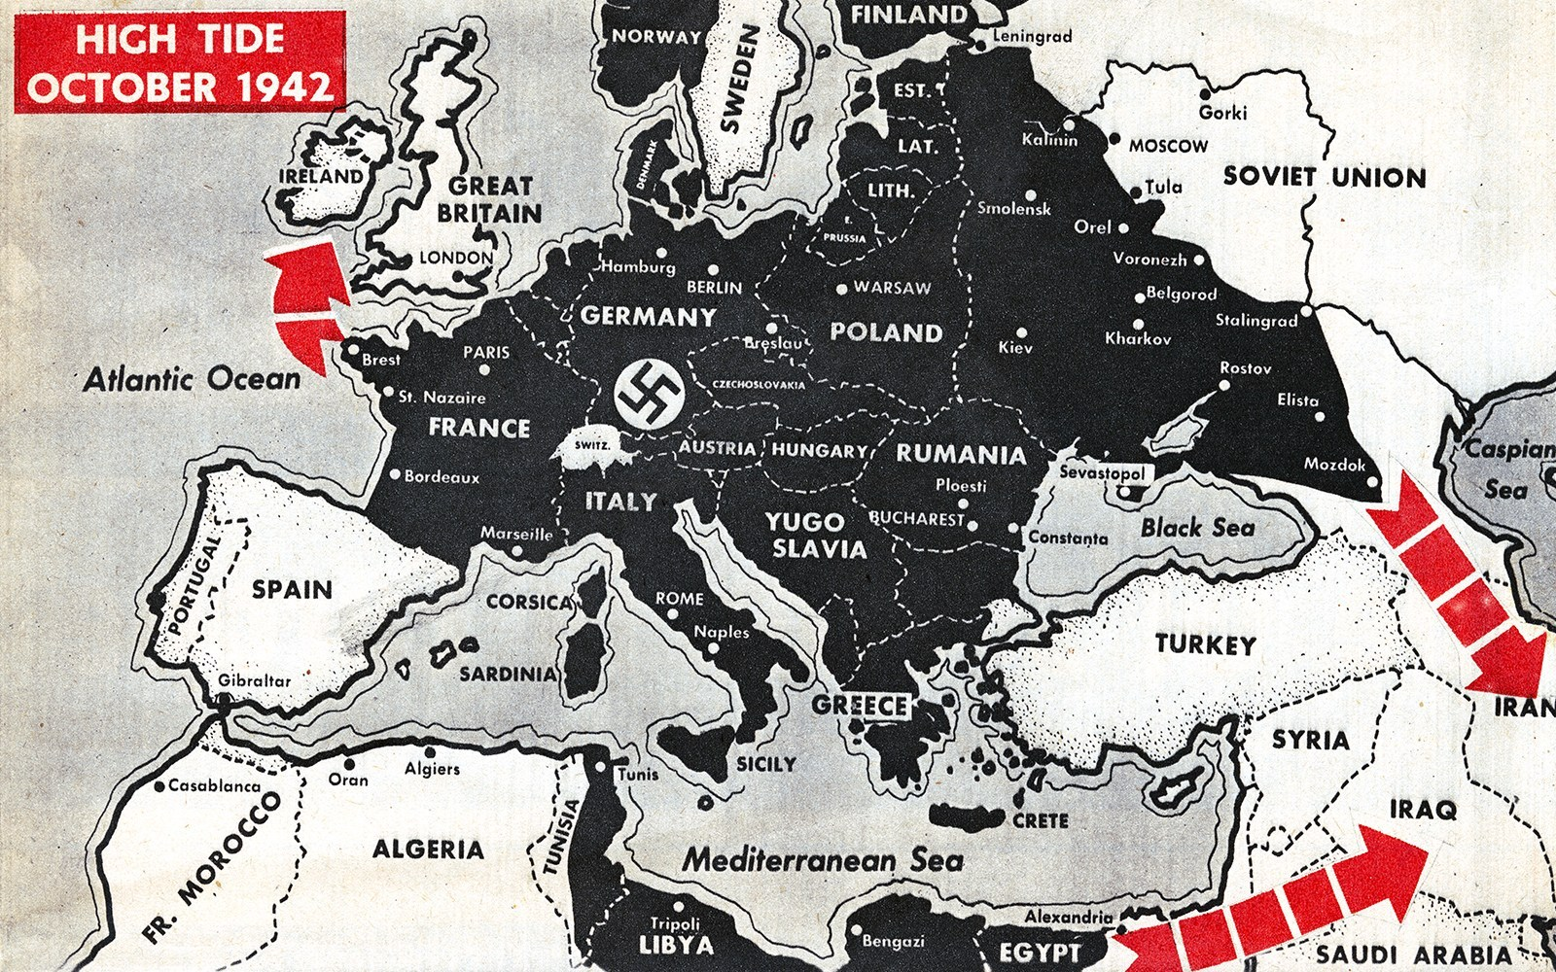

Slide 24
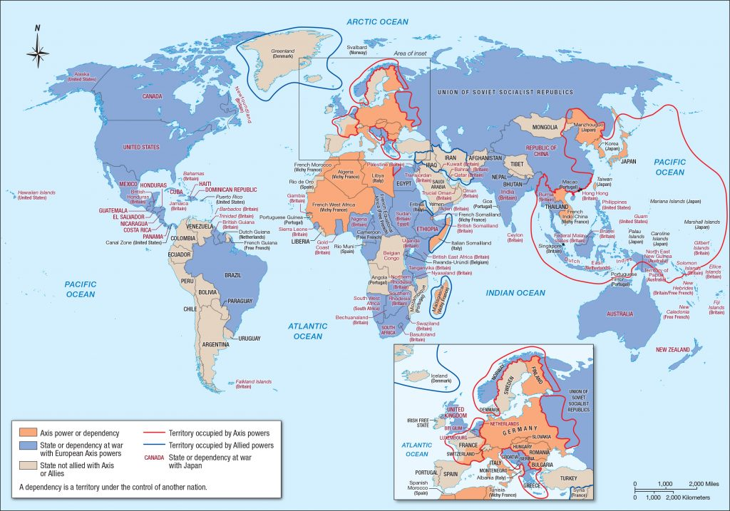

Slide 25
United States at Total War
U.S. military reaches personnel peak of 18 million men!
39 percent volunteer, 61 percent drafted (US National World War II Museum)
War production boards: CEOs as military officers, labor cooperation, coordinate all parts of production, logistics, intel, operations planning.
Massive growth, employment shortage.
Women and everyone else on homefront in demand for labor.
Fear and security measures in US.
Victory gardens and war bonds.

Slide 26
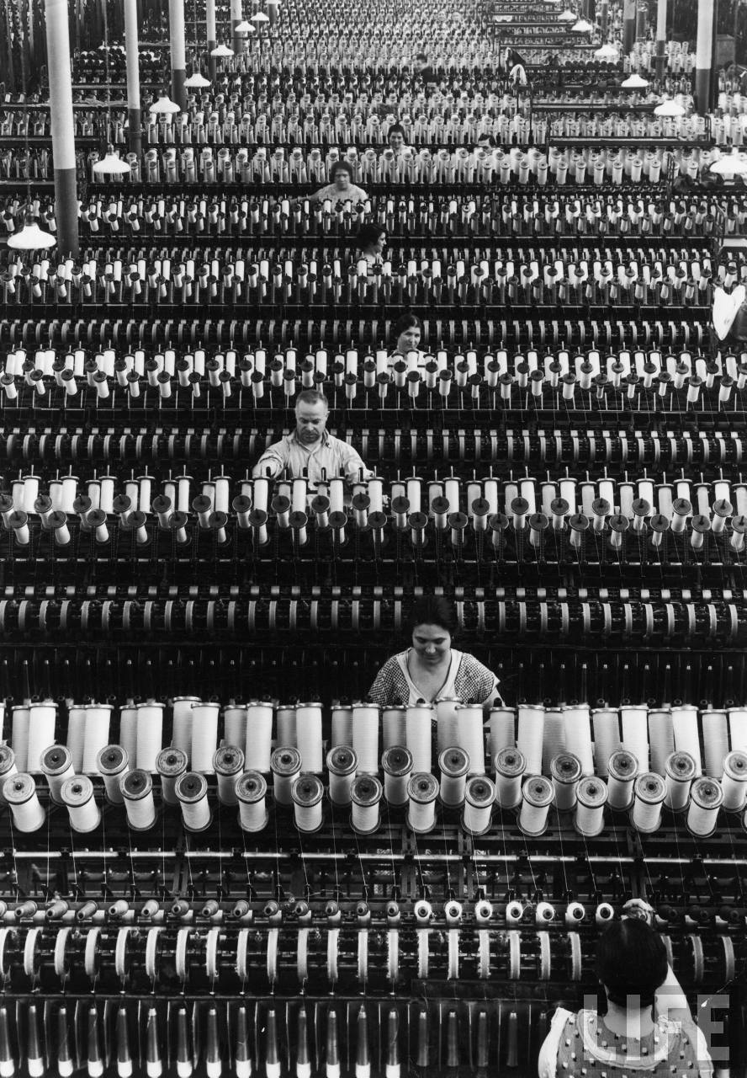
image
reality

Slide 27
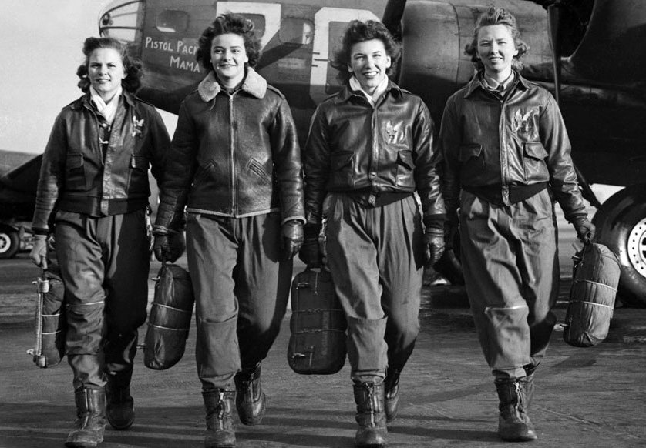

Slide 28
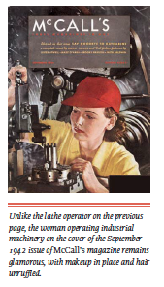
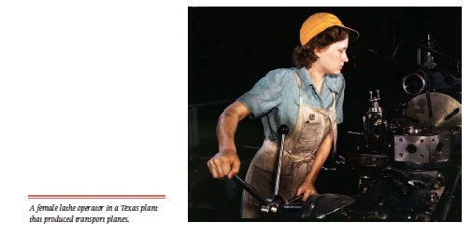
(Foner, 3rd ed., photos on 923 and 922)

Slide 29


Slide 30
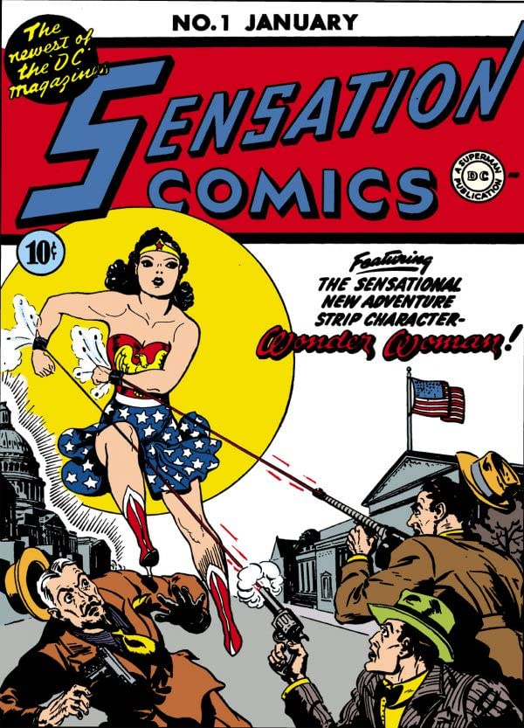
Wonder Woman
(Marston & Peter)
Created well after Pearl
Harbor as a superhero
for girls, Wonder Woman
also joined the war effort.
After the war she had
fantasy-type adventures
and became less macho
(and less popular). →

Slide 31
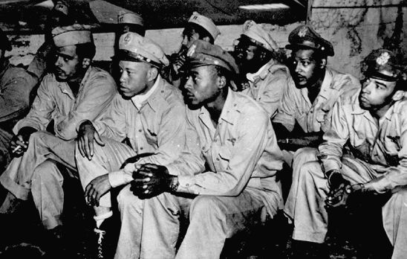

Slide 32
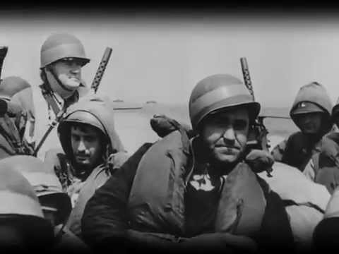

Slide 33
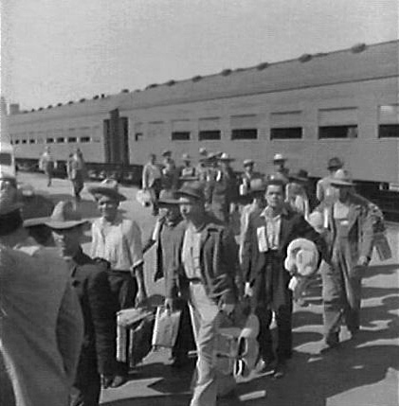
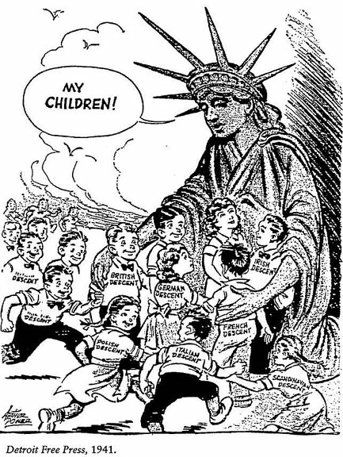

Slide 34
Who is missing?
In US society during the war, which groups are subject to “flips” in the way they are regarded by the majority?

Slide 35
planning for endgames and postwars

Slide 37
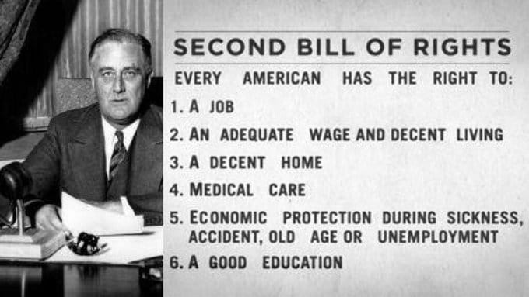

Slide 39
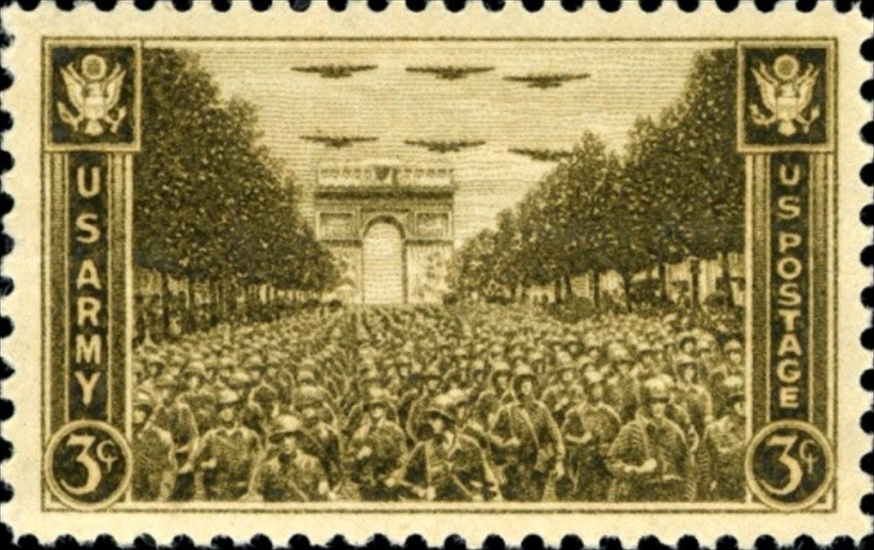

Slide 40
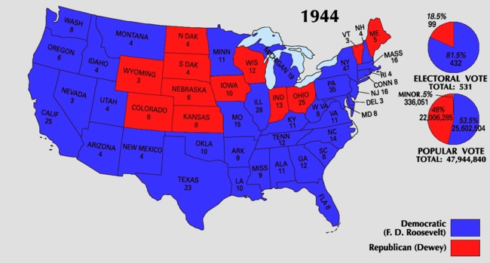

Slide 41
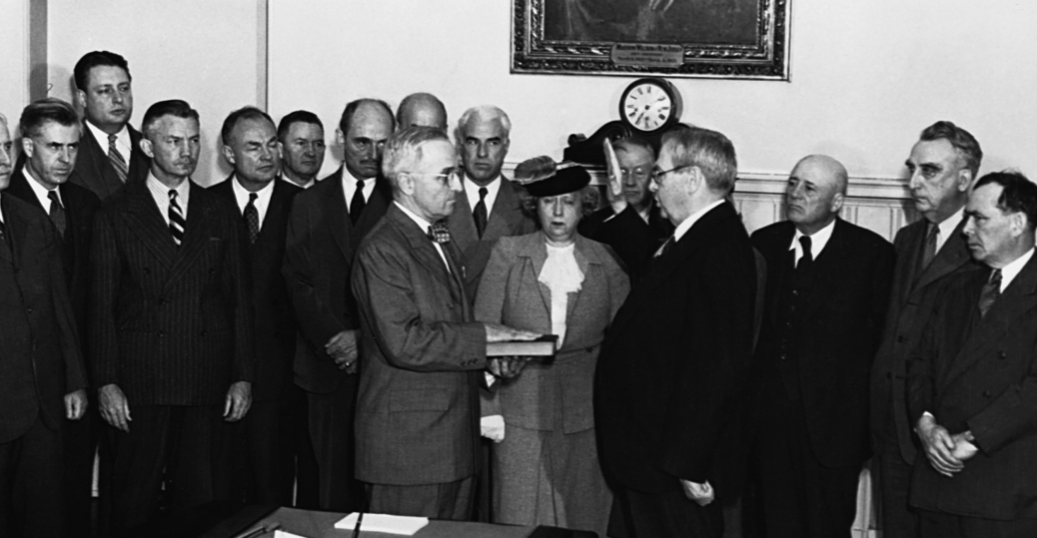

Slide 42
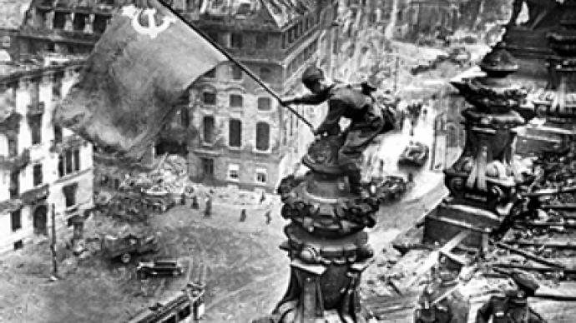

Slide 43
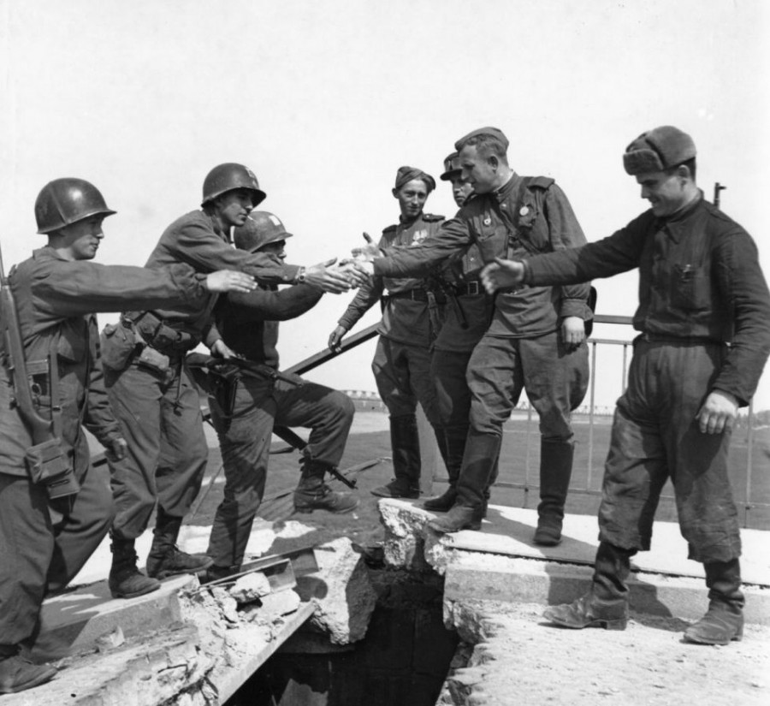

Slide 44
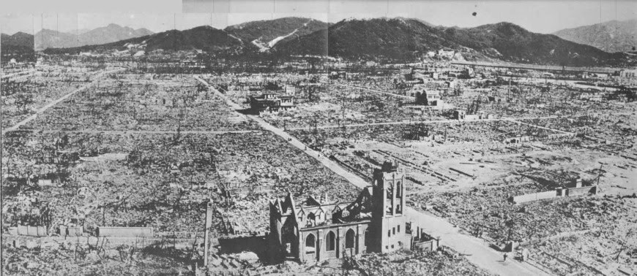

Slide 45
domestic postwar

Slide 46
G.I. Bill making a new postwar America
pays for college education
guarantees home mortgages
but… (limitations)
An affluent society? In many ways…

Slide 47
The Taft–Hartley Act (1947) amended the 1935 National Labor Relations Act (NLRA), prohibiting unions from engaging in several "unfair labor practices." Among the practices prohibited by the act are jurisdictional strikes, wildcat strikes, solidarity or political strikes, secondary boycotts, secondary and mass picketing, closed shops, and monetary donations by unions to federal political campaigns. The NLRA also allowed states to pass right-to-work laws banning union shops. Enacted during the early stages of the Cold War, the law required union officers to sign non-communist affidavits with the government.

Slide 48
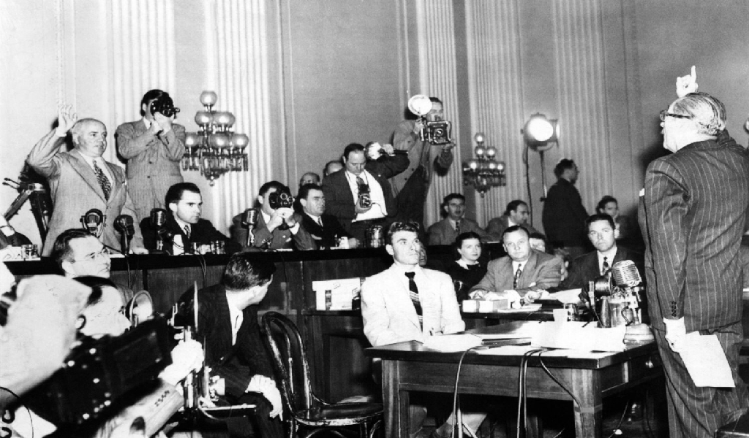

Slide 49
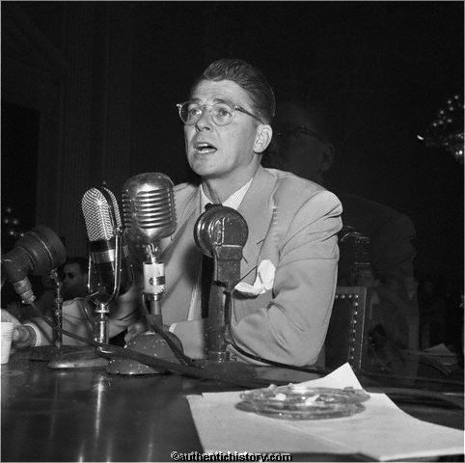
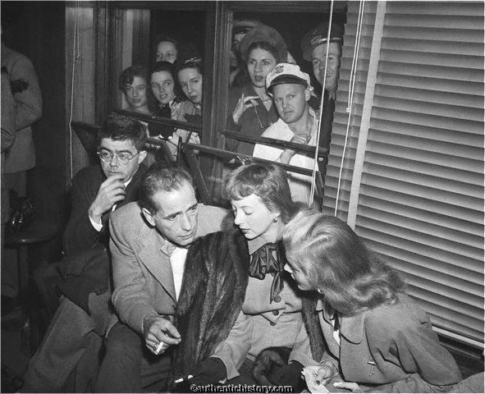

Slide 50
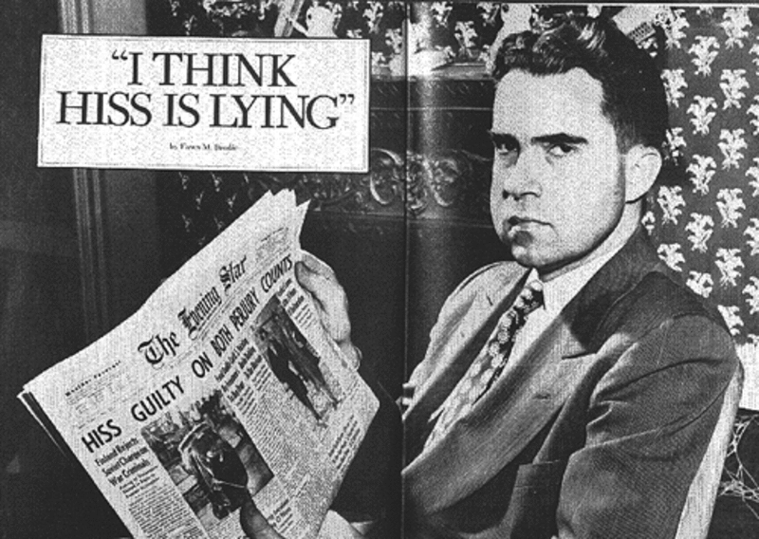

Slide 51
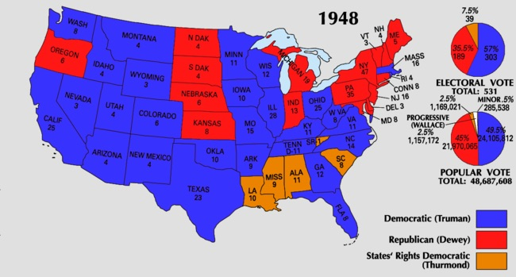

Slide 52
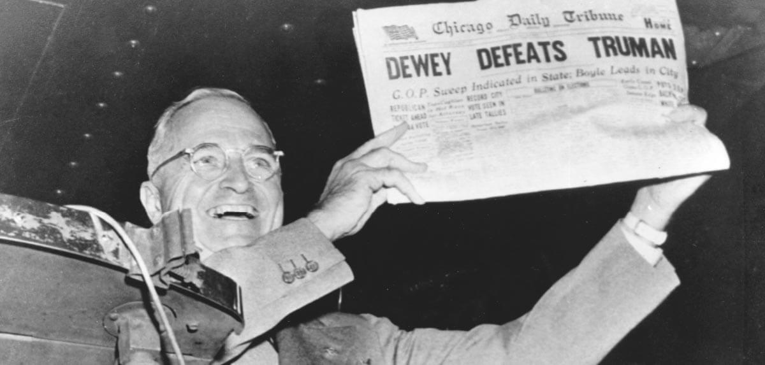

Slide 53
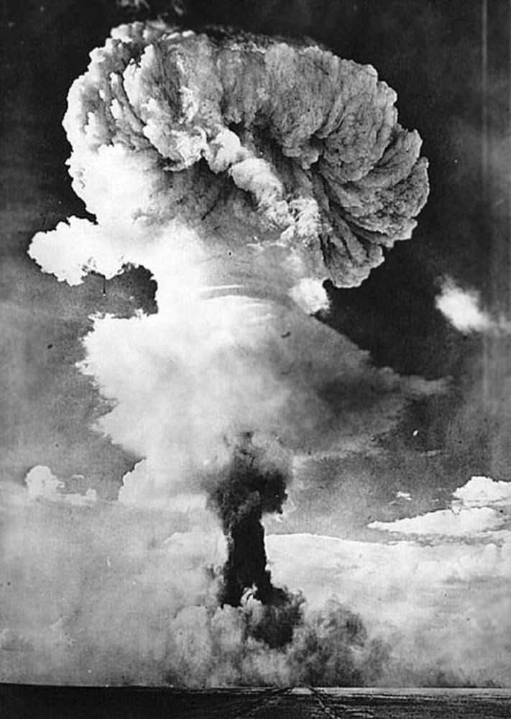
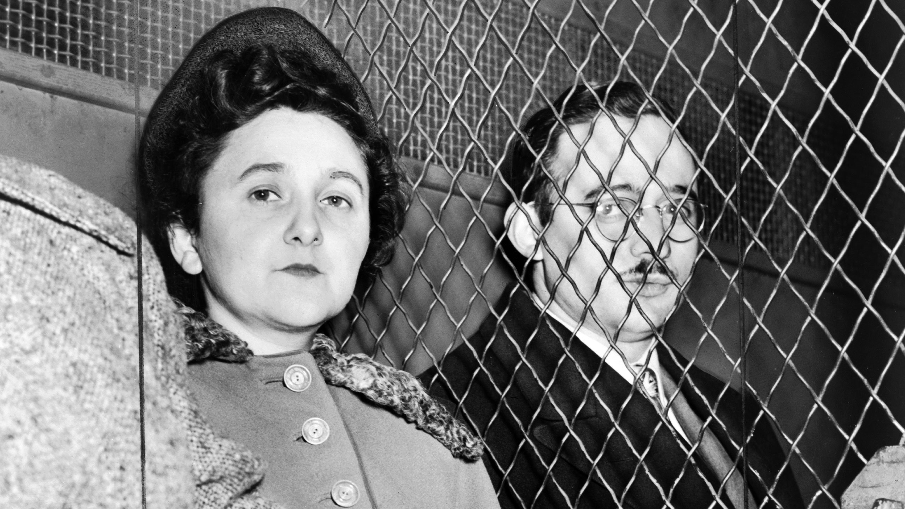

Slide 54
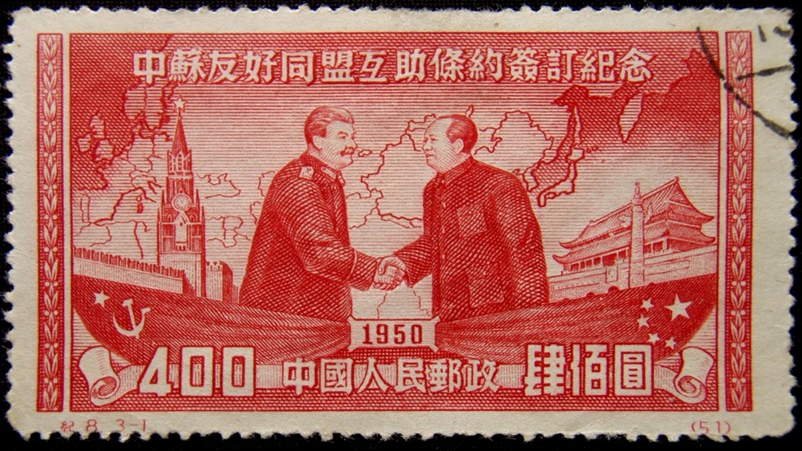

Slide 55
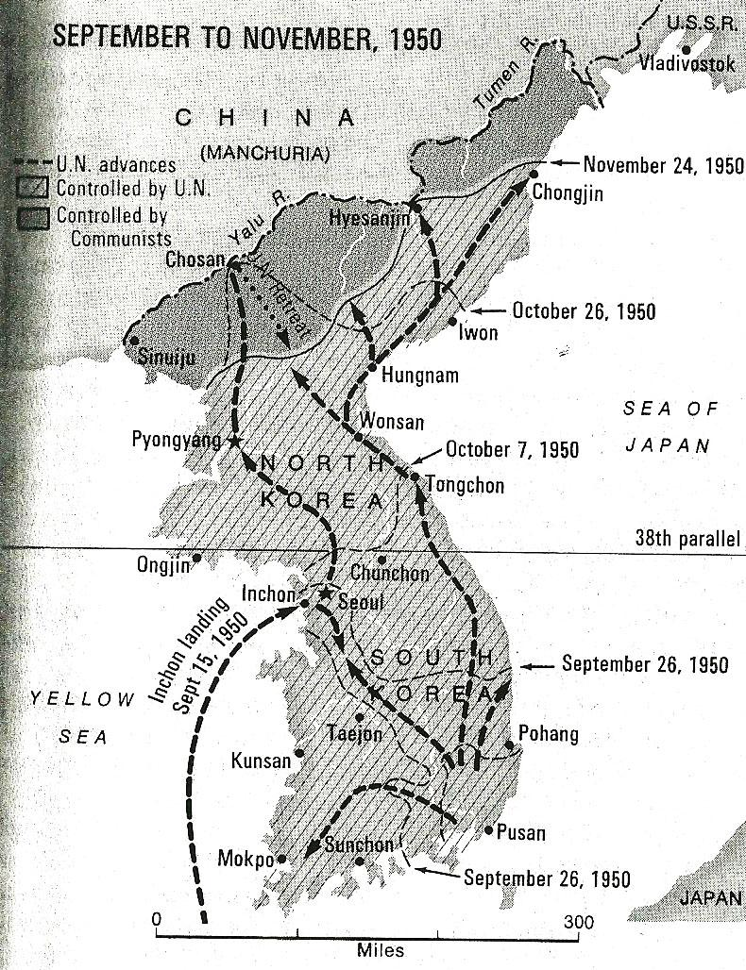

Slide 56
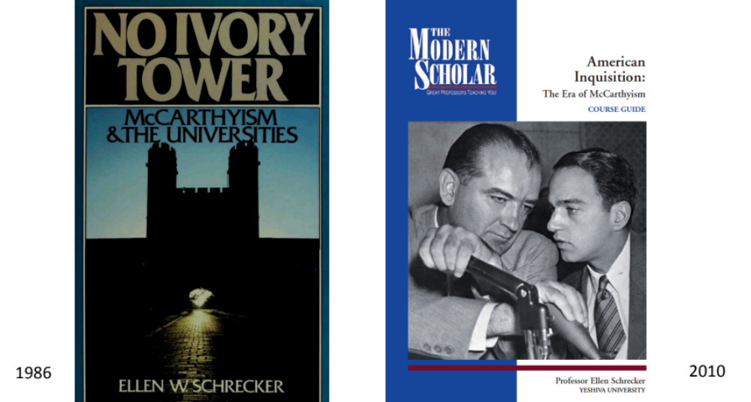

Slide 57
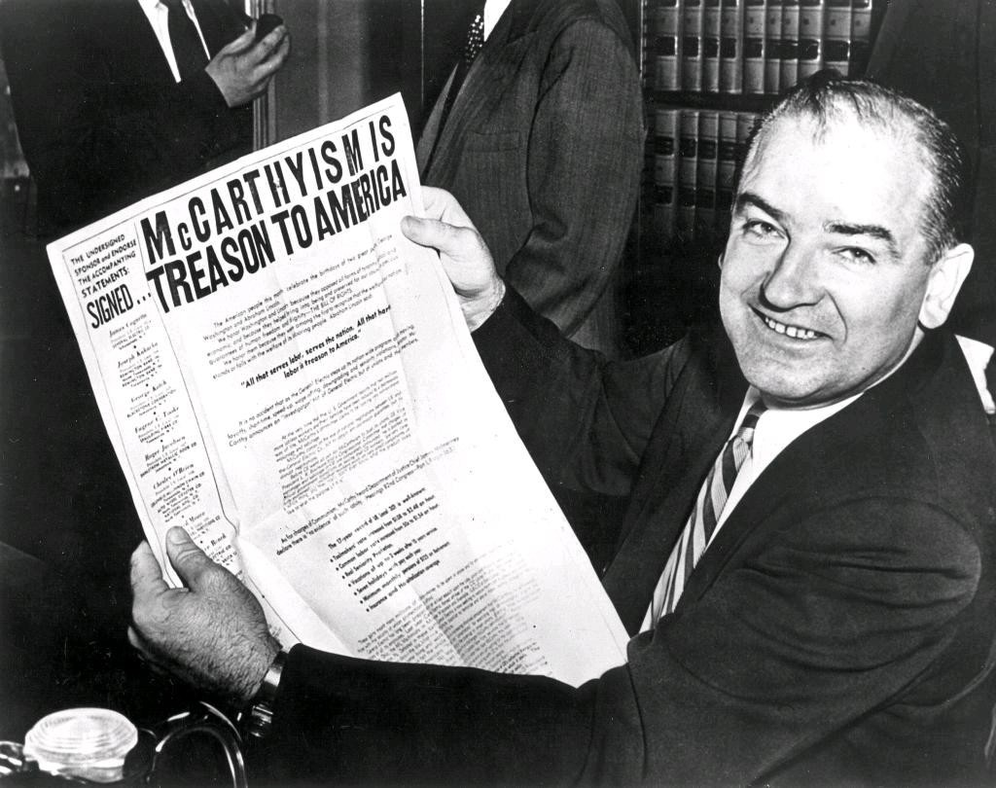

Slide 58


Slide 59


Slide 60


Slide 61
new consumer economy

Slide 62


Slide 63


Slide 64


Slide 65



Slide 66



Slide 67


Slide 68


Slide 69



Slide 70


Slide 71




Slide 72


Slide 73


Slide 74

LAND USE IN
THE UNITED
STATES, 2018
Source: Merrill and Leatherby,
Bloomberg, 31 March 2018
https://www.bloomberg.com/graphics/2018-us-land-use/

